Slide 1











PPRESENTED BY
D.ABHISHEK REDDY(RA2111030010164)
S.SATHYA DARRSHAN (RA2111030010173)
P.B.SUMANTH REDDY(RA211030010188)

Slide 2




















Slide 3
















Slide 4
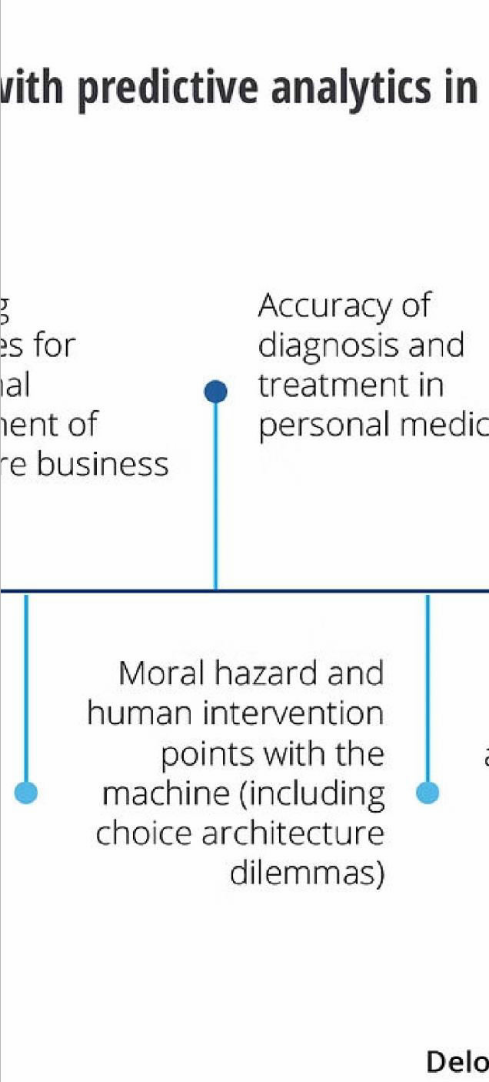
















Slide 5

















Slide 6



























Slide 7

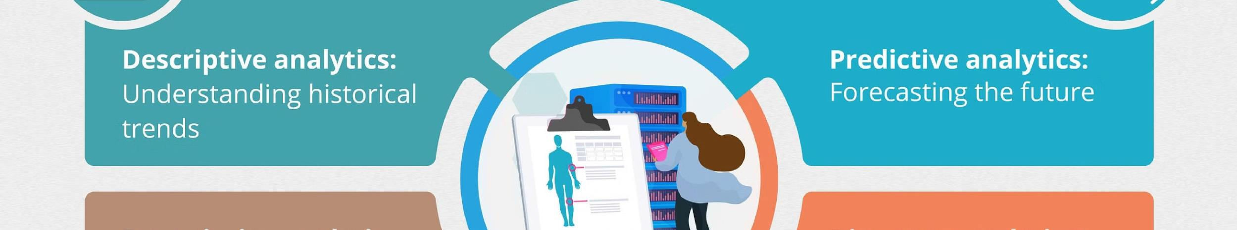























Slide 8








